Slide 1
Recent Developments of the Commodity Prices
Katrin Knauf
Hamburgisches WeltWirtschaftsInstitut (HWWI)
Notes:
Hamburgisches WeltWirtschaftsInstitut (HWWI)

Slide 2
Agenda
Development of the commodity price index
Short overview about the development of the energy raw materials Index
Recent developments on the crude oil market
Quick overview of the industrial commodities
Brief impression on the HWWI beverages and food index
page 2
Notes:
2

Slide 3
Development of the HWWI index

Slide 4
Overview commodity price index
index is divided into three main parts. Each part is again divided into several subparts of commodities and represents commodity groups:
Total index (all commodities):
Food total
Industrial raw materials
Energy raw materials
And the Total excl. energy
index gives an overview of the current price trends in primary commodity markets
page 4

Slide 5
Overview commodity price index
HWWI publishes a monthly press release about the latest developments on commodities
Since October 2018, the report is also available in English
Central banks regularly use this data set for their analyses and reports
page 5

Slide 6
Summary of recent index development energy raw materials

Slide 7
Index of enery raw materials
index is divided into crude oil, natural gas and coal
Crude oil price has fallen in autumn 2018, and but has increased in the 4 months in 2019
Natural gas prices have been declining since November 2018
Coal prices have been dropping since July 2018
page 7

Slide 8
Index of enery raw materials
This April the index for:
Coal registered 15 %
Natural gas registered 18 %
Crude oil registered 0,5 %
below the level of April 2018
Natural gas price have been declining since November 2018
warm winters lead to less demand
Coal price has been dropping since July 2018
Demand weakens because of environmental restrictions in China
page 8

Slide 9
Recent development crude oil

Slide 10
Recent development crude oil
In September 2018 crude oil hit 80 USD per barrel for the first time since 2014
Since October 2018, crude oil prices have declined due to poor world economic forecasting
Since November US sanctions against Iran are in place
Crude oil export should be prevented
Temporary exceptions for 8 countries
ended on Mai 2nd 2019
In December 2018 monthly average crude oil price has dropped to 55 USD per barrel.
page 10

Slide 11
Recent development crude oil
OPEC+ meeting in Vienna in early December
Reduction of output by 1.2 mio barrel per day
Crude oil price kept declining because reduction was deemed not to be enough
continuous increase since January
In April average crude oil price listed at 69 USD
Crude oil price registers around the previous year's level
page 11

Slide 12
Recent development crude oil

Slide 13
Recent development crude oil
The index contains the 3 most important reference blends
European crude oil of the variety Brent
Middle East crude oil of the variety Dubai
American crude oil of the variety West Texas Intermediate (WTI)
US produces record amounts of crude oil and shale oil
WTI is the least expensive variety
page 13

Slide 14
Geopolitical risks on the crude oil market
OPEC cancelled the regular meeting in April 2019
Forecast for supply and demand very difficult at the moment, no decision possible
Supply cuts from December 2018 will be valid until June 2019
Next regular meeting is scheduled for June 2019
However, the current price trend is subject to a range of supply-side risks and demand risks:
Most immediate risk, trade conflict between US and China
Iran: ongoing sanctions on crude oil export
Venezuela: instable situation, possible civil war
Libya: unstable in ongoing civil war
page 14

Slide 15
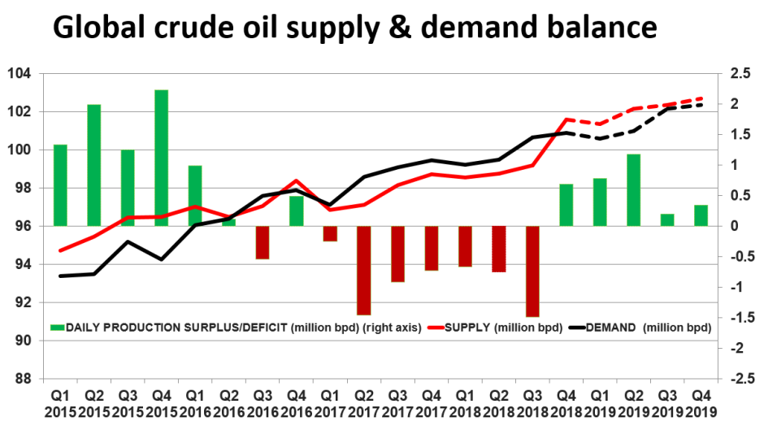
Future Development Crude oil 2019
Source: ABC, IEA
page 15

Slide 16
Future Development Crude oil 2019
The international energy agency (IEA) expects production surplus for the rest of 2019, unless the OPEC decides on further production cuts
OPEC meeting on June 25th and June 26th 2019
Decision about future supply quota is expected
World bank expects oil price around 66 USD per barrel in 2019 and 65 USD per barrel in 2020.
page 16

Slide 17
Summary of recent index development industrial raw materials

Slide 18
Index industrial raw materials
This index is divided into
Agricultural raw materials
Non-ferrous metals
Iron ore and steel scrap
Agricultural raw materials index includes sawn wood
The prices fall because of declining construction activity in the US
page 18

Slide 19
Index industrial raw materials
The index non-ferrous metals includes prices for:
Aluminum
Lead
Copper
Nickel
Zinc
Tin
The non-ferrous prices decreased because of the weakening economic world growth, notably in China, especially due to the trade conflict between the US and China
page 19

Slide 20
Index industrial raw materials
The iron ore prices increased over 30 %
Supply disruption
Fire at a Rio Tinto’s export terminal
Collapse of Brumadinho dam
Both events took place in Brazil, the largest supplier for iron ore
Price for steel scrap reduced due to falling demand
reduced growth of the Chinese economy
punitive duties of the US burden demand for steel products
page 20

Slide 21
Food and beverages

Slide 22
Food and beverages
Good harvests caused the price of coffee and cocoa to drop
The price of cocoa rose last month as crop failures in Kenya due to drought lowered expectations of crop yields
The election of the new Brazilian president Bolsonaro revalued the Brazilian real against the USD, coffee prices rose because American financial market participants had speculated on falling prices.

Slide 23
Thank you for your attention!
Bedankt voor uw aandacht!
Visit www.hwwi.org

